Slide 1


PART 3
Monitoring Asterisk with Prometheus
Prometheus.conf
Omid Mohajerani

Slide 2
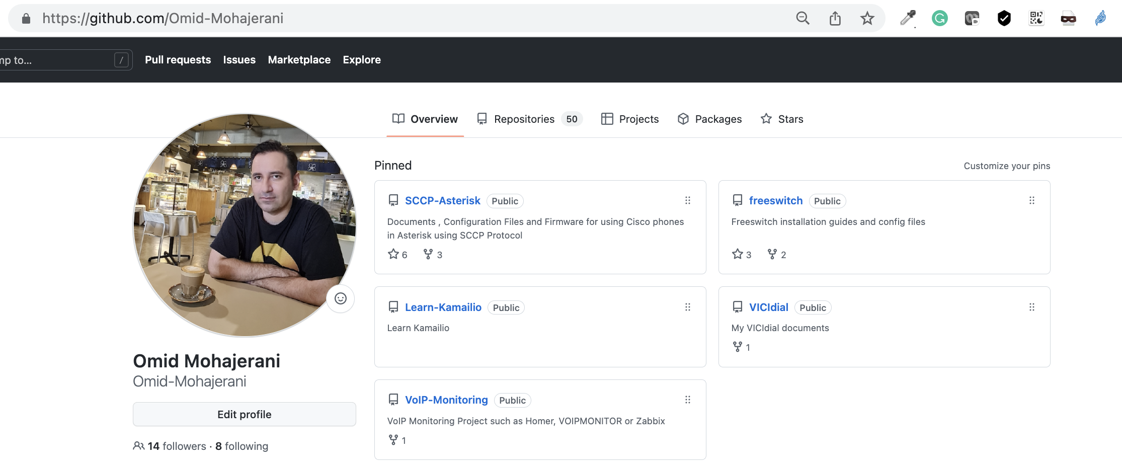
Notes:
You can find these sample configuration files that Im explaining about hee in my github VoIP-Monitorring Repo. You can find the link in the description of the video .

Slide 3
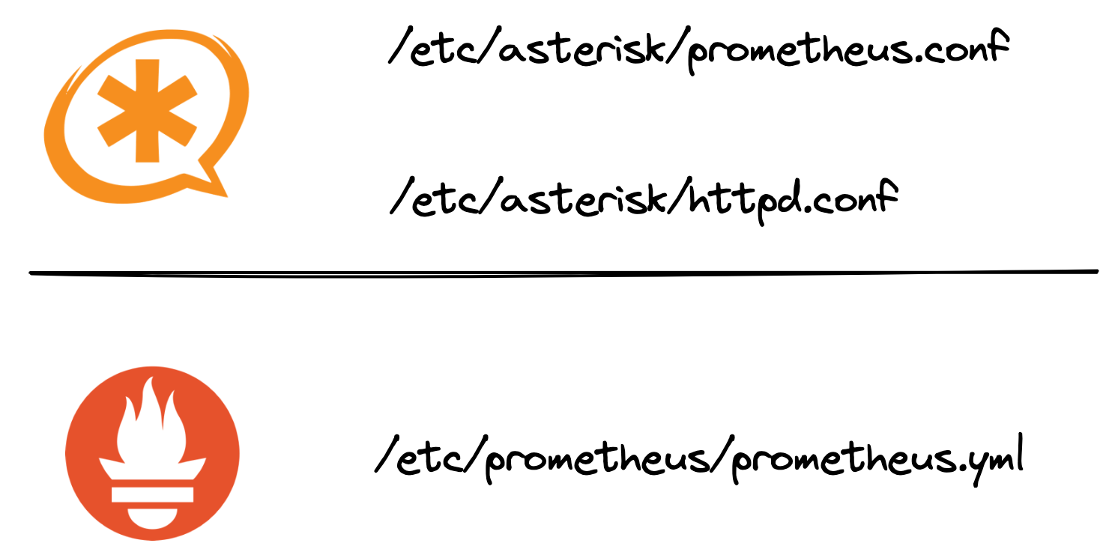
Notes:
Prometheus.conf in /etc/asterisk directory is the main configuration file that we need to touch . We can enable exposing asterisk metrics by setting enabled tag to yes and set authentication using auth_username and auth_password

Slide 4
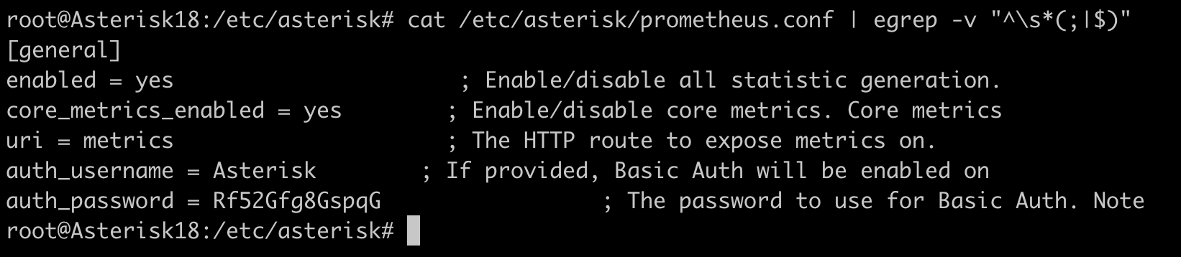
Notes:
Prometheus.conf in /etc/asterisk directory is the main configuration file that we need to touch . We can enable exposing asterisk metrics by setting enabled tag to yes and set authentication using auth_username and auth_password

Slide 5
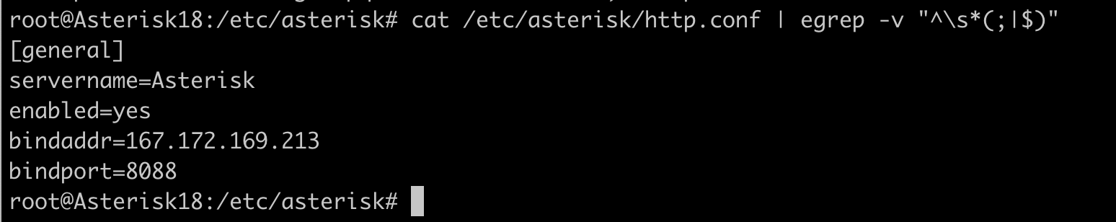
Notes:
Next step is to enable Asterisk Built-in mini-HTTP server. In order to do that edit /etc/asterisk/httpd.conf file and set the options to enable the Asterisk Built-in mini-HTTP server , IP address and Bind port . The default port is 8088

Slide 6
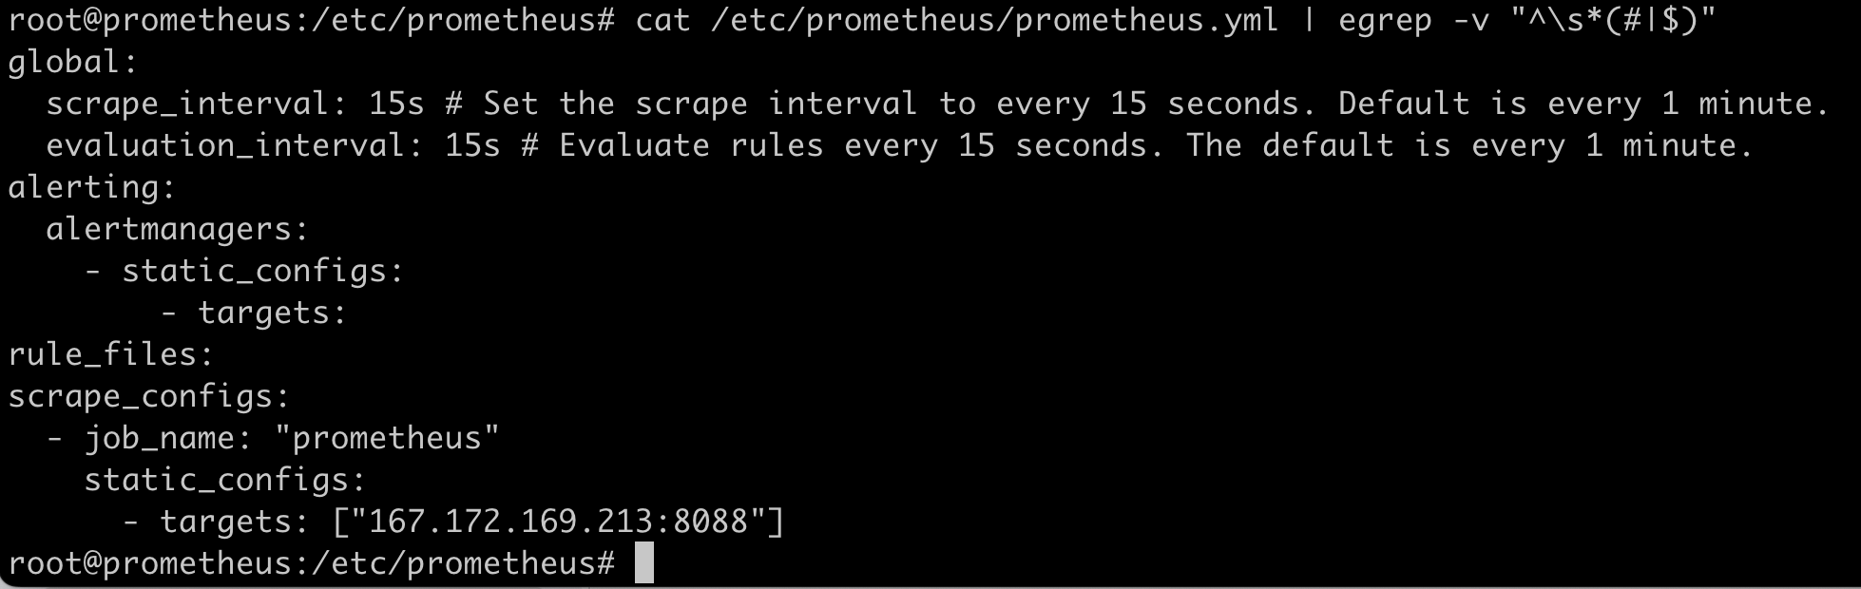
Notes:
And Finally we need to inform our Prometheus server to connect to our asterisk exposed metrics via http and scrape them . In order to do that we can define a new job and lets name it asterisk servers and define the target as our asterisk box . We neeed to pass the username and password we have define in our asterisks Prometheus.conf file to authenticate .

Slide 7
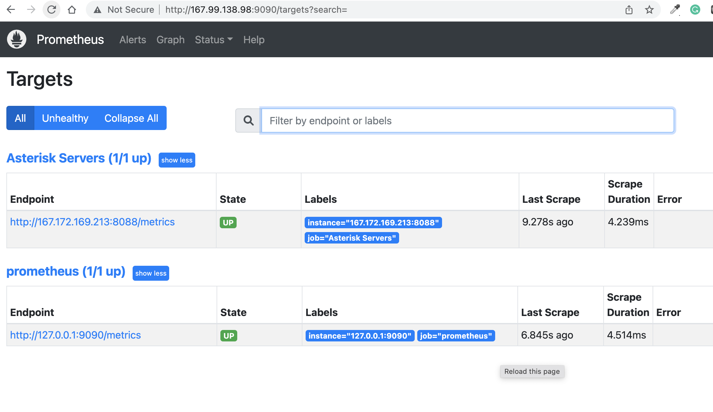
Notes:
In order to test you can point to your Prometheus server ip address port 9090 / targets
And yes . We are now monitoring asterisk metrics via promethues .

Slide 8
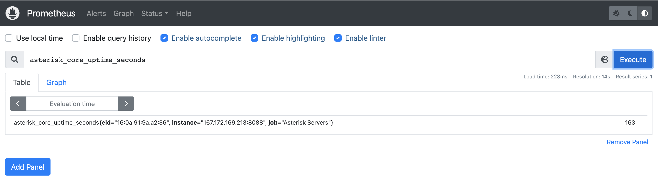
Notes:
And you can query them in the Prometheus. Of course in order to have more meaning full set of monitoring we still need to set rules or even write some promql queries that we will lean in the next vidoes but now we have all built in asterisk metrics in our Prometheus server that we can use in the later stages.
Thank you for watching this video and we will in touch through my channel to learn more about this powerfull system.

